Slide 1
Real Time Collaboration on Building Models
Submitted by :
Anjana Muraleedharan Nair Matriculation Number: 125512
Prasamsa Nandanan Matriculation Number: 125288
Selva Ganapathy Elangovan Matriculation Number: 124769
Vishal Sanjay Shivam Matriculation Number: 125353

Slide 2
AGENDA
Introduction
Problem Statement
Objective
Methodology
Implementation
Challenges Faced
Future Direction
Conclusion

Slide 3
FLOW CHART
Identifying Project Objectives
Literature Research
System Architecture Design and Implementing Software Components
System Testing and Monitoring System Performance
Documentation and Report Writing

Slide 4
Application Scenario
Remote Collaboration Optimization
Facility Management Efficiency
Renovation Project Coordination

Slide 5
INTRODUCTION - OVERVIEW OF THE PROJECT
The project aims to develop a comprehensive solution for automating data updating and distribution across multiple systems in real time.
Key Components:
RDF (Resource Description Framework)
IFC (Industry Foundation Classes)
SPARQL queries
XML Serialization
TCP listeners

Slide 6
PROBLEM STATEMENT
Building Information Modelling (BIM) technology has advanced significantly, but real-time updating of Industry Foundation Classes (IFC) files from Revit still poses challenges.
Conventional methods lack automatic synchronization between Revit and IFC files.
This deficiency leads to inefficiencies in data exchange and collaboration among project stakeholders.

Slide 7
OBJECTIVES
Automated real-time updates: Develop a solution to automatically update the IFC files in Revit in real-time when the modifications are done to the Revit model.
Enhance data manipulation: Implement functionalities using XBIM library efficiently manipulate BIM entities within the REVIT model.
Efficient communication infrastructure: Develop a robust communication infrastructure utilizing TCP Listener to facilitate data exchange between the REVIT model and external systems.

Slide 8
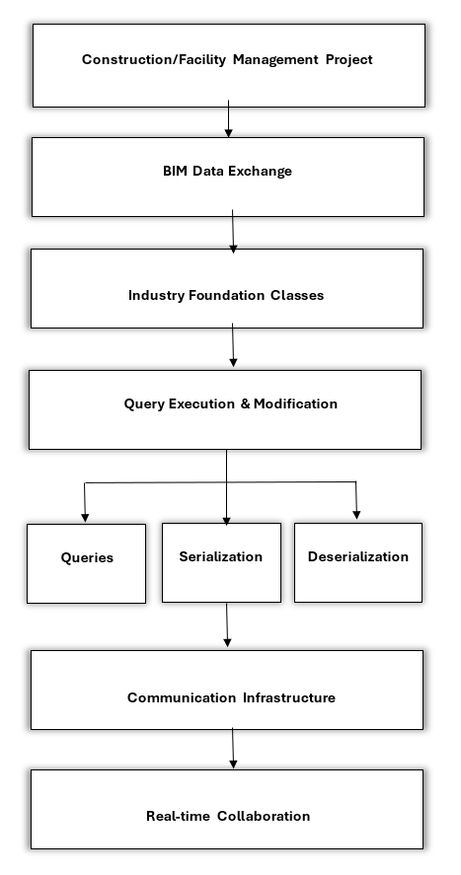
METHODOLOGY
Automated Data Updating: Streamline process.
Queries for Modification: Targeted adjustments.
Serialization & Deserialization: Enhance exchange.
Real-Time Collaboration: Robust infrastructure.
Efficiency & Accuracy Boost: Reliable solution.

Slide 9
TCP Communication Process
TCP ensures reliable and connection-oriented communication between devices over IP-based networks.
Serialized XML data is transmitted from System1 to System2 .
System1 acts as the TCP Client and System2 acts as the TCP server
System2 updates the RDF database
Acknowledges the target systems.

Slide 10
USE CASES
Modify the name of an existing wall.
Set the name of a newly created wall.
Add owner history information to an existing wall entity.
Add Property set and associated properties to an existing wall entity within the building model.

Slide 11
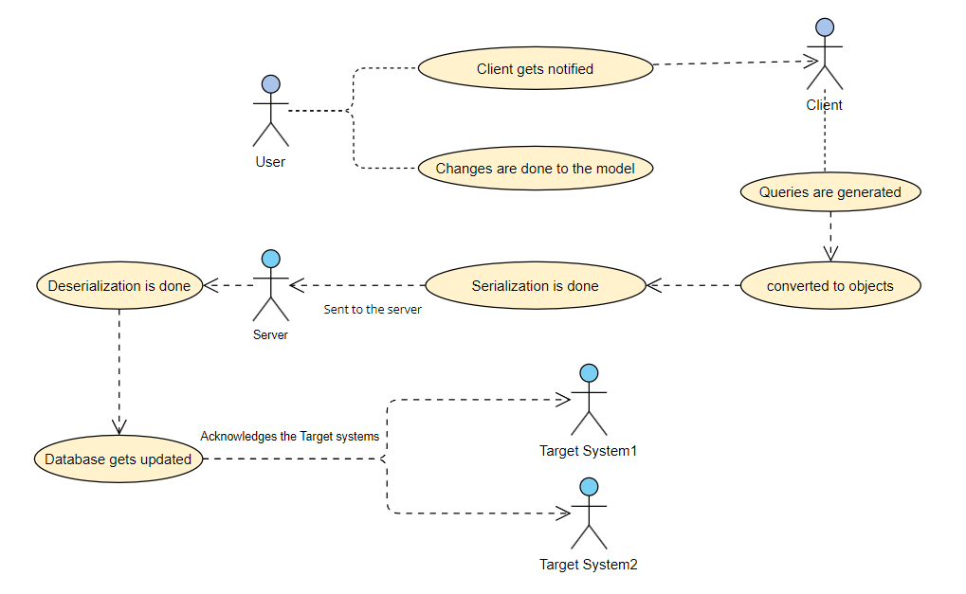
USE CASE DIAGRAM

Slide 12
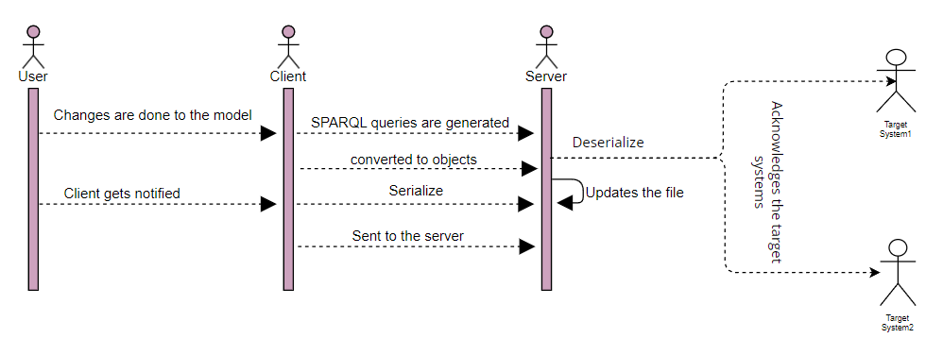
SEQUENCE DIAGRAM

Slide 13
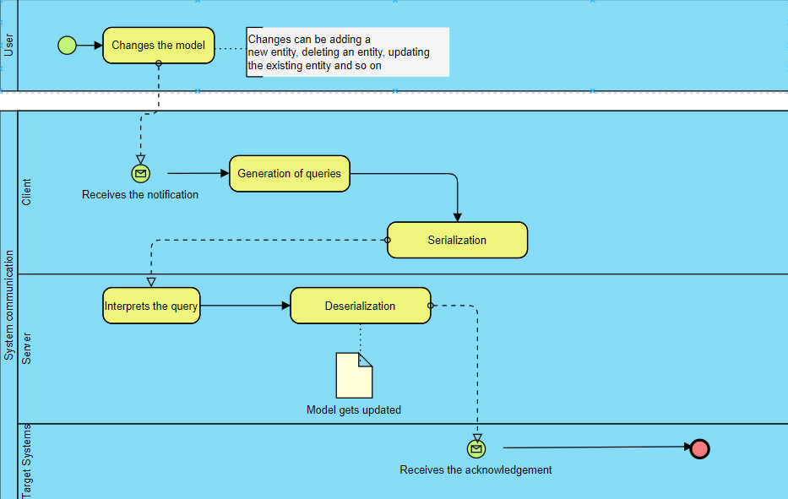
BPMN

Slide 14
IMPLEMENTATION
Generated SPARQL queries.
Serialization and sending to the server
Deserialization and updation of RDF data.
Acknowledges target clients.

Slide 15
CHALLENGES FACED
Initial Attempt with BIM Server
Trouble with Apache Jena Server and Updating IFC File
Discovering the Need to Convert IFC to RDF
Challenges with SPARQL Query Generation
Difficulty in Deserializing XML Object and Updating Turtle File

Slide 16
LIMITATIONS
Scalability
Technical Expertise Requirements
Implementation and Validation
Security and Privacy issues

Slide 17
CONCLUSION
Developed a comprehensive solution for real-time collaboration and synchronization between Revit models and IFC files.
Utilized RDF, IFC, SPARQL queries, XML Serialization, and TCP listeners to enable real-time data management.
Enabled standardized data representation and integration.

Slide 18
FUTURE DIRECTIONS
User action with Unity.
Updation of IFC file using different approaches.

Slide 19
THANK YOU

